Slide 1
Computer Architecture & Assembly Language
CSC-250
COURSE LECTURE
COMPUTER SCIENCE DEPARTMENT
SIBAU KANDHKOT CAMPUS

Slide 2
Puzzle:
There are four people who want to cross a rickety bridge; they all begin on the same side. You have 17 minutes to get them all across to the other side. It is night, and they have one flashlight. A maximum of two people can cross the bridge at one time. Any party that crosses, either one or two people, must have the flash light with them. The flash light must be walked back and forth; it cannot be thrown, for example.
Person 1 takes 1 minute to cross the bridge, person 2 takes 2 minutes, person 3 takes 5 minutes, and person 4 takes 10 minutes.
A pair must walk together at the rate of the slower person’s pace.
(Note: According to a rumor on the Internet, interviewers at a well-known software company located near Seattle have given this problem to interviewees.

Slide 3
Tricky Travelling Salesman Problem (TSP) - Class Activity
💡 Problem Statement:
A delivery person named Alex works for QuickExpress Delivery. Alex must deliver packages to five different cities:
City A (10 km from the start)
City B (15 km from City A, 20 km from the start)
City C (30 km from City B, 25 km from City A)
City D (5 km from City B, 10 km from City C, 40 km from the start)
City E (20 km from City A, 25 km from City C, 35 km from City D, 50 km from the start)
Alex must start and end at the warehouse while visiting each city exactly once.
Challenge for Students:
Find the shortest route for Alex to take.
Calculate the total distance traveled for that route.
Suggest a real-world strategy (e.g., using a map or software) to optimize the route.
If a road between two cities is closed, how would you adjust the route?
🎯 Goal: Find the most efficient way to minimize Alex’s total travel distance! 🚛💨
Let me know if you want modifications! 😊

Slide 4
Processor Micro-Processor CPU
A processor, or "microprocessor," is a small chip that resides in computers and other electronic devices. Its basic job is to receive input and provide the appropriate output
A microprocessor is a programmable electronics chip that has computing and decision making capabilities.
Are They the Same?
❌ No, they are not exactly the same.
✔ A microprocessor is a type of processor, but not all processors are microprocessors.
✔ A processor can refer to CPUs, GPUs, microcontrollers, and other processing units.
✔ A microprocessor is specifically a CPU on a single chip, designed for computers, embedded systems, and automation devices.
.

Slide 5
Processor Micro-Processor CPU
Microprocessor communicates and operates in binary numbers 0 and 1.
The set of instructions in the form of binary patterns is called a machine language and it is difficult for us to understand.
Therefore, the binary patterns are given abbreviated names, called mnemonics, which forms the assembly language.
The conversion of assembly-level language into binary machine-level language is done by using an application called assembler.

Slide 6
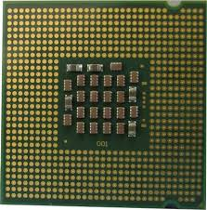
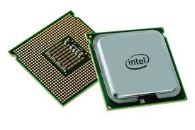
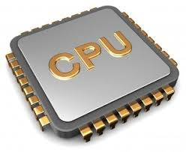
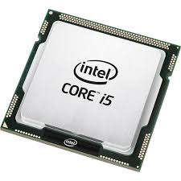
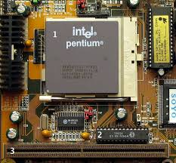

Slide 7
Processor Required Busses
Address Bus: It carries the address, which is a unique binary pattern used to identify a memory location or an I/O port. The locations in hexadecimal format can be written as 00H – FFH.
Data Bus: The data bus is used to transfer data between memory and processor or between I/O device and processor. For example, an 8-bit processor will generally have an 8-bit data bus and a 16-bit processor will have 16-bit data bus.
Control Bus: The control bus carry control signals, which consists of signals for selection of memory or I/O device from the given address.

Slide 8
Evolution of Microprocessors
4-bit Microprocessors
The first microprocessor was introduced in 1971 by Intel Corp.
It was named Intel 4004 as it was a 4 bit processor.
It was a processor on a single chip. It could perform simple arithmetic and logic operations such as addition, subtraction, AND - OR
It had a control unit capable of performing control functions like fetching an instruction from memory, decoding it, and generating control pulses to execute it. It was able to operate on 4 bits of data at a time.
This first microprocessor was quite a success in industry. Soon other microprocessors were also introduced. Intel introduced the enhanced version of 4004.

Slide 9
Evolution of Microprocessors
8-bit Microprocessors
The first 8 bit microprocessor which could perform arithmetic and logic operations on 8 bit words was introduced in 1973 again by Intel.
This was Intel 8008 and was later followed by an improved version,
Intel 8088. Some other 8 bit processors are Zilog-80 and Motorola M6800.
16-bit Microprocessors
The 8-bit processors were followed by 16 bit processors.
They are Intel 8086 and 80286.
32-bit Microprocessors
The 32 bit microprocessors were introduced by several companies but the most popular one is Intel 80386.

Slide 10
X86 Processor Family
x86 is a family of instruction set architectures initially developed by Intel based on the Intel 8086 microprocessor and its 8088 variant. The term "x86" came into being because the names of several successors to Intel's 8086 processor end in "86", including the 80186, 80286, 80386 and 80486 processors
1978 (16-bit), 1985 (32-bit), 2003 (64-bit)
x86 is a term used to describe a CPU instruction set compatible with the Intel 8086 and its successors, including the Pentium and others made by Intel and other companies. This is the CPU architecture used in most desktop and laptop computers. Many 21st century workstations and servers also use x86 processors

Slide 11
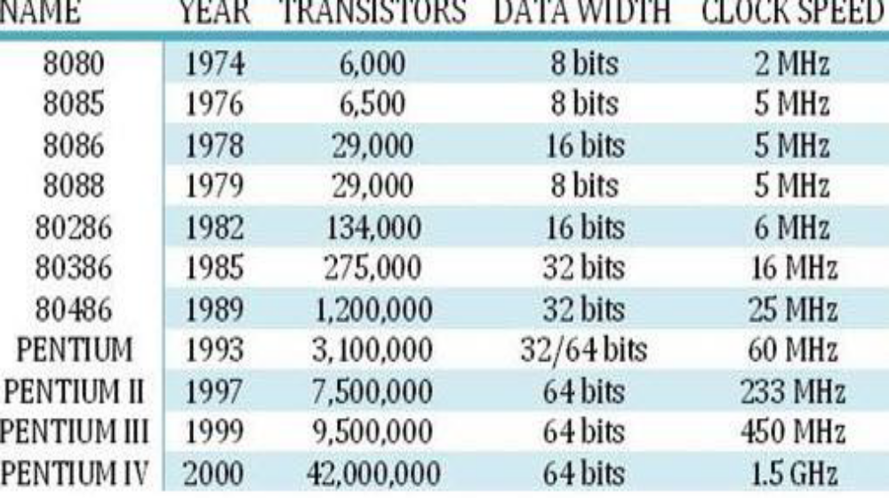
Henrich Hertz
Cycle is a Pulse
Series of On/Off or like switching
Architecture Update by generations
MHz = 1 million
GHz = 1 Billion
A transistor is the fundamental building block of a processor (CPU). It acts as a switch or amplifier that controls the flow of electrical signals, enabling the CPU to perform computations.

Slide 12
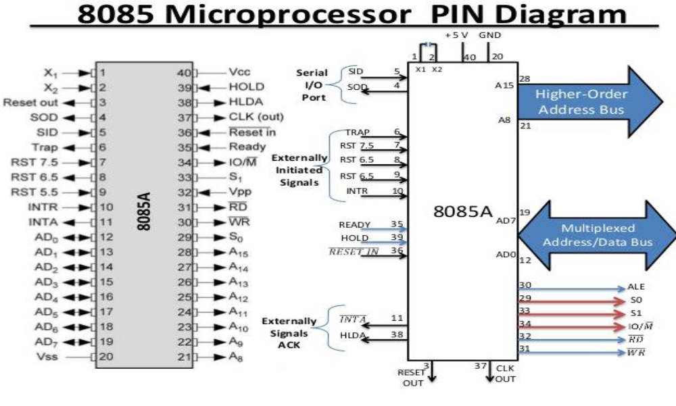

Slide 13
Intel Pentium & Power PC Evaluation
Pentium Series 1993
Instead of 80586, Intel came out with a new processor namely Pentium processor.
Its performance is closer to RISC performance but follow CISC. Pentium was followed by Pentium Pro CPU. Pentium Pro allows multiple CPUs in a single system in order to achieve multiprocessing.
Pentium 4 & Itanium series organization occurs

Slide 14
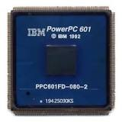
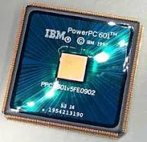
Power PC Processor
PowerPC is a reduced instruction set computer (RISC) instruction set architecture (ISA) created by the 1991 Apple–IBM–Motorola alliance, known as AIM.
‎List of PowerPC processors · ‎PowerPC 600 · ‎PowerPC e700 · ‎PowerPC 5000
Bits: 32-bit/64-bit (32 → 64)
The three developing companies have made the PowerPC architecture an open standard, inviting other companies to build on it.

Slide 15
Intel Pentium & Power PC Evaluation
The intel Pentium represents the result of decades of design effort on complex instruction set computers
The power PC are the first descendant (driven from) of first RISC system.
8080 first general purpose microprocessor 8 bit machine with 8 bit data path to memory was used in first personal computer ALTAIR
Core processor properties (i series i3,i5, i7) 2006

Slide 16
Intel Pentium & Power PC Evaluation
In 1975, IBM started the 801 minicomputer project that launched the RISC movement. In 1986, IBM developed a RISC workstation, the RT PC, which was not a commercial success.
In 1990, introduced the RISC/6000 and marketed that as a high performance workstation. IBM began to refer to this as the POWER architecture.
IBM then entered into an alliance with Motorola the developer of the 68000 series for Apple computers.
The result of this alliance was the series of microprocessors that implement the PowerPC architecture. The processors in the series were: 601, 603, 604, 620, 740/750 (G3), G4, and G5.

Slide 17
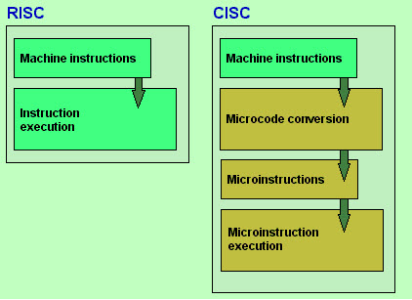
Reduced and Complex Instruction Set Computer
RISC
whereas the PowerPC processors are completely RISC-based
Reduce the cycles per instruction at the cost of the number of instructions per program.
CISC
Intel Pentium processors are mainly CISC-based, with some RISC facilities built into them.
The CISC approach attempts to minimize the number of instructions per program but at the cost of increase in number of cycles per instruction.

Slide 18
RISC (Reduced Instruction Set Computer)
RISC uses a small, simple set of instructions that are executed quickly.
Instructions take one clock cycle to execute (most of the time).
Focuses on load/store architecture, meaning data must be loaded into registers before processing.
Uses hardwired control (instead of microprogramming) for faster execution.

Slide 19
CISC versus RISC
CISC | RISC
Emphasis on hardware | Emphasis on software
Includes multi-clock complex instructions | Single-clock, reduced instruction only
Memory-to-memory: "LOAD" and "STORE" incorporated in instructions | Register to register: "LOAD" and "STORE" are independent instructions
Small code sizes, high cycles per second | Low cycles per second, large code sizes
Transistors used for storing complex instructions | Spends more transistors on memory registers

Slide 20
Intel Pentium & Power PC Evaluation
A Pentium processor is mainly intended for casual usage like browsing, light gaming and doing school projects and such other examples. Usually used as a home desktop
The PowerPC architecture provides an alternative to the popular processor architectures from Intel, including the Pentium. (Microsoft builds its Windows operating system offerings to run on Intel processors, and this widely-sold combination is sometimes called "Wintel".)
The PowerPC was first used in IBM's RS/6000 workstation with its UNIX-based operating system and in Apple Computer's Macintosh personal computers. Today, PowerPC chips are also used in diverse applications including internetworking equipment, routers, telecom switches, interactive multimedia, automotive control, and industrial robotics.

Slide 21
What is CISC?
CISC is an acronym for Complex Instruction Set Computer and are chips that are easy to program and which make efficient use of memory. Since the earliest machines were programmed in assembly language and memory was slow and expensive, the CISC philosophy made sense
Most common microprocessor designs such as the Intel 80x86 and Motorola 68K series followed the CISC philosophy.
But recent changes in software and hardware technology have forced a re-examination of CISC and many modern CISC processors are hybrids, implementing many RISC principles.
CISC was developed to make compiler development simpler. It shifts most of the burden of generating machine instructions to the processor. For example, instead of having to make a compiler write long machine instructions to calculate a square-root, a CISC processor would have a built-in ability to do this.

Slide 22
What is RISC?
RISC?
RISC, or Reduced Instruction Set Computer. is a type of microprocessor architecture that utilizes a small, highly-optimized set of instructions, rather than a more specialized set of instructions often found in other types of architectures.
History
The first RISC projects came from IBM, Stanford, and UC-Berkeley in the late 70s and early 80s. The IBM 801, Stanford MIPS, and Berkeley RISC 1 and 2 were all designed with a similar philosophy which has become known as RISC. Certain design features have been characteristic of most RISC processors:
  one cycle execution time: RISC processors have a CPI (clock per instruction) of one cycle. This is due to the optimization of each instruction on the CPU and a technique called PIPELINING
  pipelining: a techique that allows for simultaneous execution of parts, or stages, of instructions to more efficiently process instructions;
  large number of registers: the RISC design philosophy generally incorporates a larger number of registers to prevent in large amounts of interactions with memory

Slide 23

The Performance Equation
The following equation is commonly used for expressing a computer's performance ability:
Risc
The CISC approach attempts to minimize the number of instructions per program, sacrificing the number of cycles per instruction.
RISC does the opposite, reducing the cycles per instruction at the cost of the number of instructions per program.
cisc

Slide 24
Which one is better...?
There is still considerable controversy among experts about which architecture is better.
Some say that RISC is cheaper and faster and therefore the architecture of the future.
Others note that by making the hardware simpler, RISC puts a greater burden on the software. Software needs to become more complex. Software developers need to write more lines for the same tasks.

Slide 25
Recent Developments & Future Scope
EPIC :
The biggest threat for CISC and RISC might not be each other, but a new technology called EPIC.
EPIC stands for Explicitly Parallel Instruction Computing. EPIC can do many instruction executions in parallel to one another.
EPIC is a created by Intel and is in a way a combination of both CISC and RISC. This will in theory allow the processing of Windows-based as well as UNIX-based applications by the same CPU.
Intel is working on it under code-name Merced. Microsoft is already developing their Win64 standard for it. Like the name says, Merced will be a 64-bit chip.

Slide 26

ARM Processor : Advanced RISC Machine
An ARM processor is one of a family of CPUs based on the RISC (reduced instruction set computer) architecture developed by Advanced RISC Machines (ARM). ARM makes 32-bit and 64-bit RISC multi-core processors.
ARM processors are microprocessors and are widely used in many of the mobile phones sold each year, as many as 98% of mobile phones. They are also used in PDAs (personal digital assistants), digital media and music layers, hand-held gaming systems, calculators, and even computer hard drives.

Slide 27
ARM Processor
Companies that are current licensees of the 64-bit ARMv8-A core designs include AMD, AppliedMicro (X-Gene), Broadcom, Calxeda, HiSilicon, Rockchip,
Arm's latest top-end processor core design – the Cortex-A76 unveiled today – is its first CPU to only run kernel-level code that is 64-bit, according to its inventors.

Slide 28
ARM Processor
There are three main CPU architectures used in today's Android phones. ARM is perhaps the most common, as it's optimized for battery consumption. ARM64 is an evolution of the original ARM architecture that supports 64-bit processing for more powerful computing, and it's quickly becoming the standard in newer devices
Why ARM is most popular: ARM is the most popular processors, particularly used in portable devices due to its low power consumption and reasonable performance. ARM has got better performance when compared to other processors. The ARM processor is basically consisting of low power consumption and low cost.

Slide 29
ARM Ltd
Founded in November 1990
  Spun out of Acorn Computers
Designs the ARM range of RISC processor cores
Licenses ARM core designs to semiconductor partners who fabricate and sell to their customers.
  ARM does not fabricate silicon itself
Also develop technologies to assist with the design-in of the ARM architecture
  Software tools, boards, debug hardware, application software, bus architectures, peripherals etc
Notes:
The ARM processor core originates within a British computer company called Acorn. In the mid-1980s they were looking for replacement for the 6502 processor used in their BBC computer range, which were widely used in UK schools. None of the 16-bit architectures becoming available at that time met their requirements, so they designed their own 32-bit processor.
Other companies became interested in this processor, including Apple who were looking for a processor for their PDA project (which became the Newton). After much discussion this led to Acorn’s processor design team splitting off from Acorn at the end of 1990 to become Advanced RISC Machines Ltd, now just ARM Ltd.
Thus ARM Ltd now designs the ARM family of RISC processor cores, together with a range of other supporting technologies.
One important point about ARM is that it does not fabricate silicon itself, but instead just produces the design - we are an Intellectual Property (or IP) company. Instead silicon is produced by companies who license the ARM processor design.

Slide 30
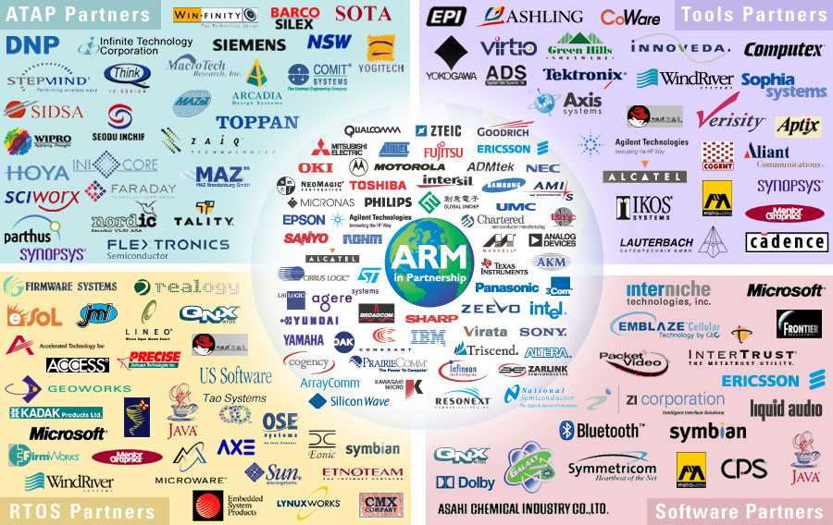
ARM Partnership Model
Notes:
ARM’s business model centres around the principle of partnership. At the centre of this are ARM’s semiconductor partners who design, manufacture and market ARM-compliant products.
Having so many partner companies producing silicon executing the same instruction set is a very important part of ARM’s strength in the market place.
However each of our semiconductor partners bring their own unique strengths to the partnership - each having their own technologies, applications knowledge, product focus, culture, geography, and key customers.
In addition to our partnering with semiconductor companies, we also partner with a large number of other third parties to ensure that operating systems, EDA and software development tools, application software and design services are available for doing ARM based designs.
“ATAP” stands for ARM Technology Access Program. Creates a network of independent design service companies and equips them to deliver ARM-powered designs. Members get access to ARM technology, expertise and support. Members sometimes referred to as “Approved Design Centers”.

Slide 31
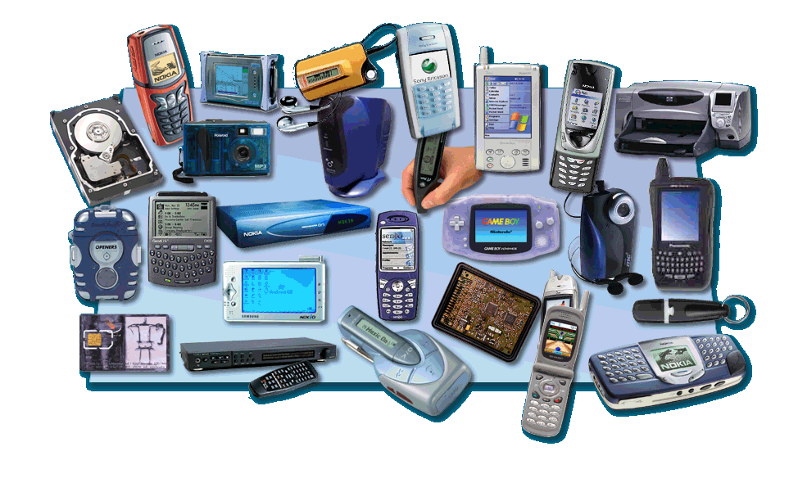
ARM Powered Products

